Slide 1

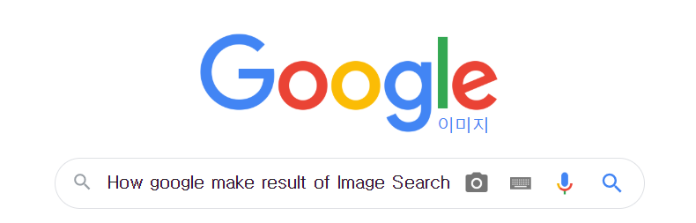
How google make result of Image Search
Google Image Search
Global Research Program
1205 Sang-Kwon Park | 1415 Jun-Min Jin | 1610 Si-Yoon Yoo

Slide 2
Contacts
1. What’s Image Search?
2. Image Search Algorithm : CBIR(Content Based Image Retrieval)
3. Image Search Algorithm : CNN(Convolutional Neural Network)
4. LIRE (Open Source)
5. Conclution

Slide 3
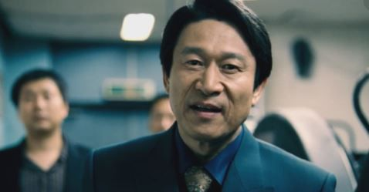
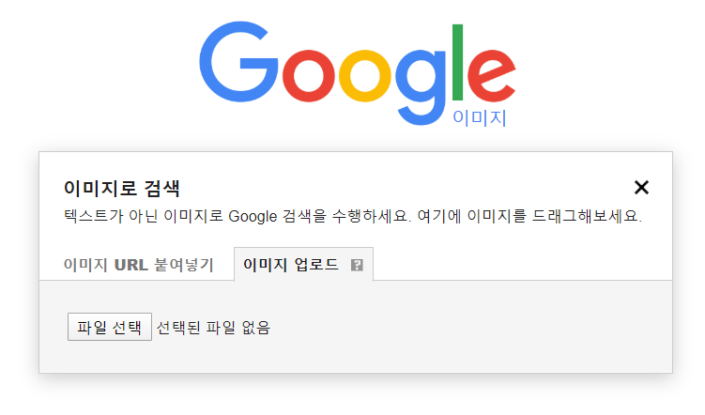
Image Search Algorithm : CBIR(Content Based Image Retrieval)
1
2
3
4
5
I want to know who he is…
First. Upload Image on google
Upload image file or link at google.

Slide 4
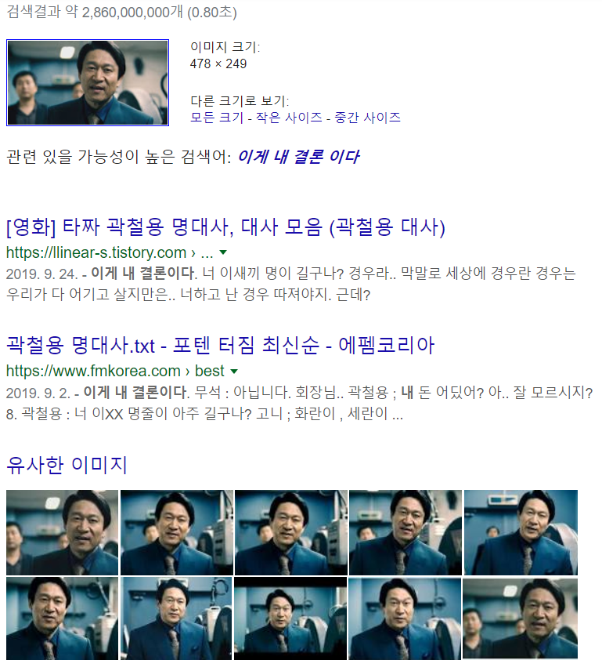
What’s Image Search?
1
2
3
4
5
Ah! He is Eung-Soo Kim who performs Chul-Yong Kwak
Second. This is Google’s result
Google find you similar images and search word. You can know who he is by some links that Google gives to you.

Slide 5


Image Search Algorithm : CBIR(Content Based Image Retrieval)
1
2
3
4
5
TBIR vs CBIR
TBIR
CBIR
Text Descriptor
(time, location, events, objects, formats, aboutness of image content, topical terms)
Difficult to maintain consistency, Reflection of contents and objectivity
Image Feature
(texture, color, shape, structure)
Sometimes may not be recognized
Twitter. Jpg(??)
(??)

Slide 6
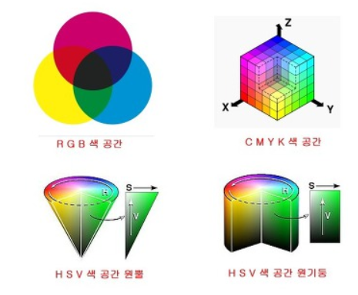
Image Search Algorithm : CBIR(Content Based Image Retrieval)
1
2
3
4
5
Algorithm
Convert Color Space
RGB does not satisfy a person's cognitive needs
RGB → HSV, YCbCr, CIE (XYZ, LUV), etc (other color space)
Normalize Histogram
reduce the number of pixels in the color depending on the size of the image.
Global Color Histogram | local color histogram | histogram hybridization method
Reduce vector space
(vector space in n x n x n) + (a lot of computation of similarity)
= Spend so many times.

Slide 7
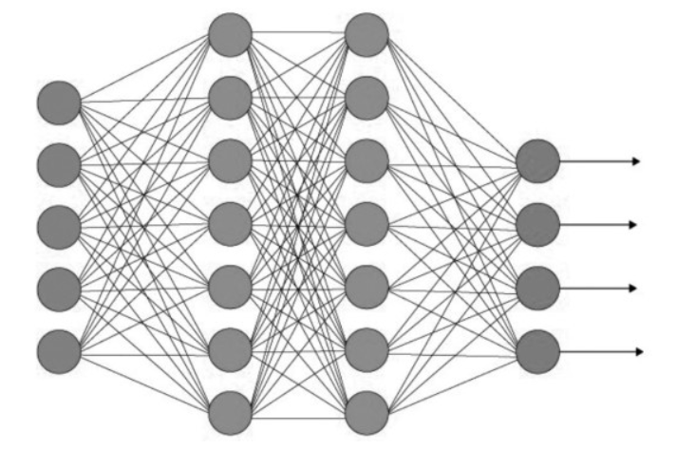
Image Search Algorithm : CNN(Convolutional Neural Network)
1
2
3
4
5
What is Convolutional Neural Network?
A set of algorithms (modeled loosely after the human brain) that are designed to recognize patterns.
A neural network finds the right f, or the correct manner of transforming x into y
Neural networks help us cluster and classify.
It looks like human’s neural cell network.

Slide 8
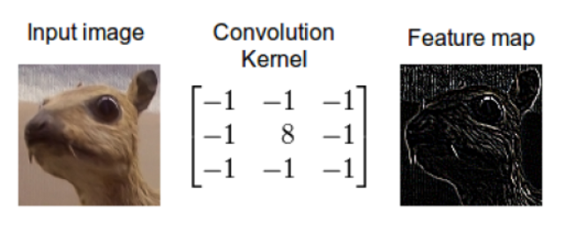
Image Search Algorithm : CNN(Convolutional Neural Network)
1
2
3
4
5
Algorithm
1. Convolution
Convolution means mixing information.
2. Activation
Feature maps are output by activation function(ReLU, sigmoid function, etc.)

Slide 9
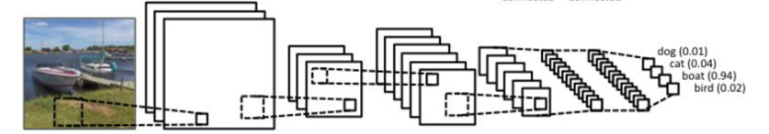
Image Search Algorithm : CNN(Convolutional Neural Network)
1
2
3
4
5
Algorithm(cont.)
3. Subsampling
Reduce our feature map’s size.
4. Repeat and classify
With repeated result, classify by using ‘fully-connected layer’(Neural Network)

Slide 10
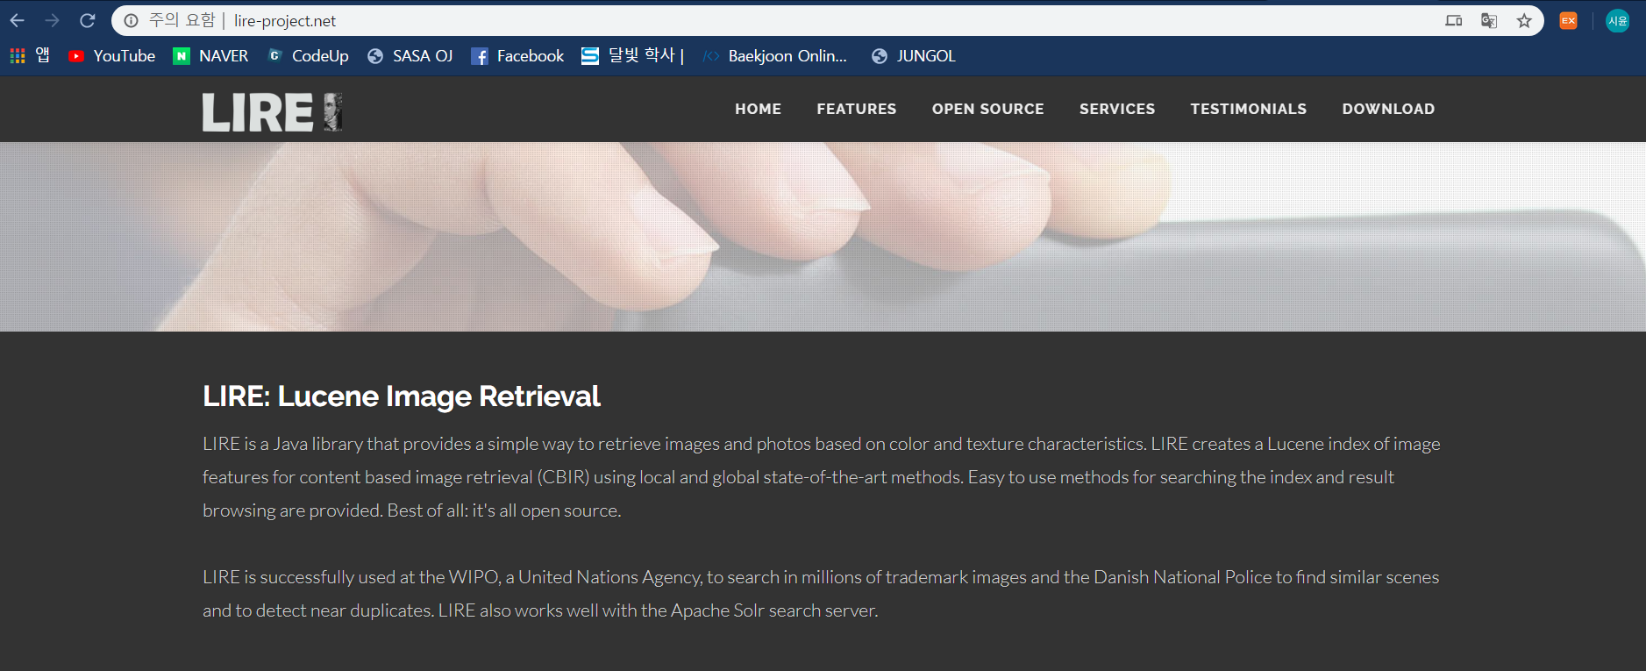
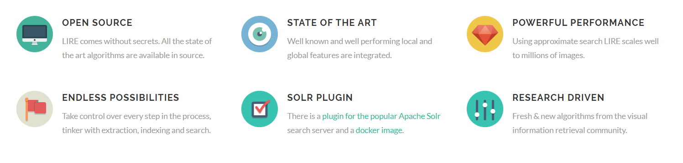

LIRE (Open Source)
1
2
3
4
5
The open sounce software about image search, LIRE

Slide 11
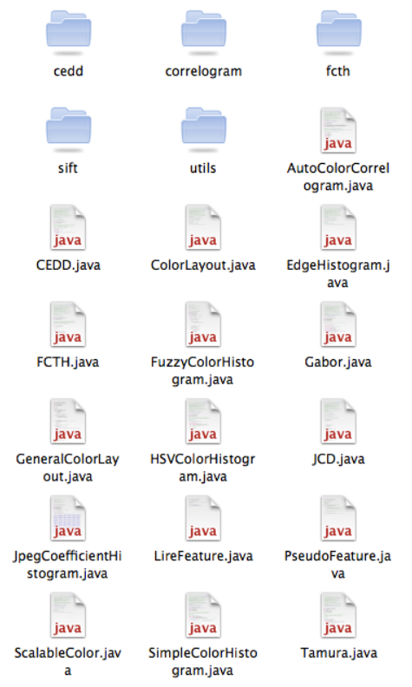
LIRE (Open Source)
1
2
3
4
5
Using LIRE
This is the package
It is work by CBIR
11 descriptors:
1. Scalable Color
2. Color Layout
3. Edge Histogram
4. Color Correlogram
5. Color Histogram
6. CEDD ( Color and Edge Directivity Descriptor )
7. FCTH ( Fuzzy Color and Texture Histogram )
8. TAMURA
9. Gabor
10. SIFT
11. SIFT Histogram

Slide 12
Conclusion
1
2
3
4
5
This is our conclusion.
Analyzing image
We didn’t know (can’t know) Google’s image search algorithm exactly.
But we know some algorithm about analyzing image (using CBIR, CNN) and we also have open source.
So we can do and improve searching image by this data which we announced.
This is my conclusion.

Slide 13
Sources
1. https://www.google.com/imghp?hl=ko
2. http://www.lire-project.net/
3. http://siru.tistory.com/attachment/cfile4.uf@241F413E58649698190F40.pdf
4. https://pathmind.com/wiki/neural-network
5. https://hamait.tistory.com/535?fbclid=IwAR2gEcDuKD2BzkIahb1BV0JDsYkQDP-r9RKQfgV_Hg9eJieuVqgd-yJSsx4
6. https://bskyvision.com/412
7. http://wittgena.blogspot.com/2011/07/lire-lucene-image-retrieval-library.html

Slide 14
THANK YOU!
For listening our presentation.
1205 Sang-Kwon Park | 1415 Jun-Min Jin | 1610 Si-Yoon Yoo

